Slide 1
Dynamic Programming

Slide 2
What is dynamic programming.?
Dynamic programming is a methodology(same as divide-and-conquer) that often yield polynomial time algorithms; it solves problems by combining the results of solved overlapping subproblems.
Main idea:
- set up a recurrence relating a solution to a larger instance to solutions of some smaller instances
- solve smaller instances once
- record solutions in a table
- extract solution to the initial instance from that table

Slide 3
Advantages of dynamic programming,
As it is a recursive programming technique, it reduces the line code.
One of the major advantages of using dynamic programming is it speeds up the processing as we use previously calculated references.

Slide 4
Disadvantages
It takes a lot of memory to store the calculated result of every subproblem without ensuring if the stored value will be utilized or not.
Many times, output value gets stored and never gets utilized in the next subproblems while execution. It leads to unnecessary memory utilization.
In DP, functions are called recursively. Stack memory keeps increasing.

Slide 5
0-1 Knapsack Problem using DP.
Given weights and values of n items, put these items in a knapsack of capacity W to get the maximum total value in the knapsack. In other words, given two integer arrays val[0..n-1] and wt[0..n-1] which represent values and weights associated with n items respectively. Also given an integer W which represents knapsack capacity, find out the maximum value subset of val[] such that sum of the weights of this subset is smaller than or equal to W.
You cannot break an item, either pick the complete item, or don’t pick it (0-1 property).

Slide 6
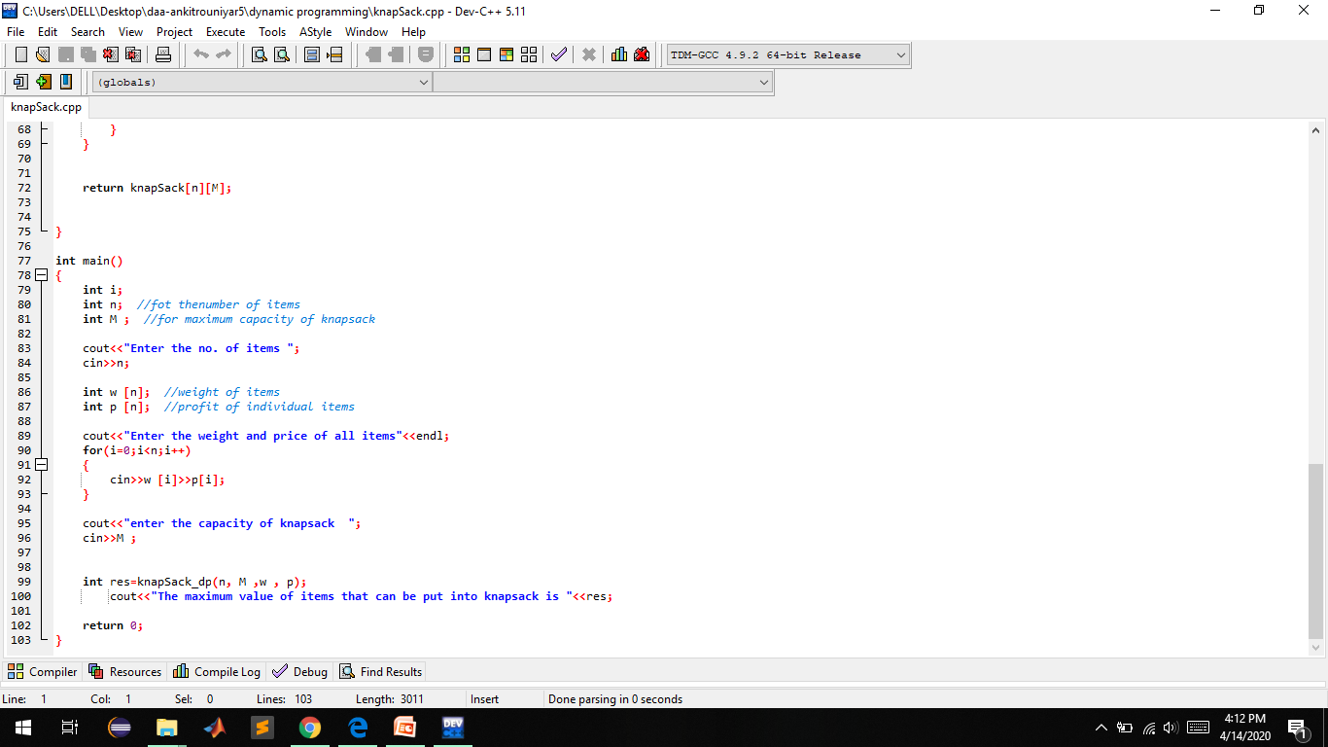

Slide 7
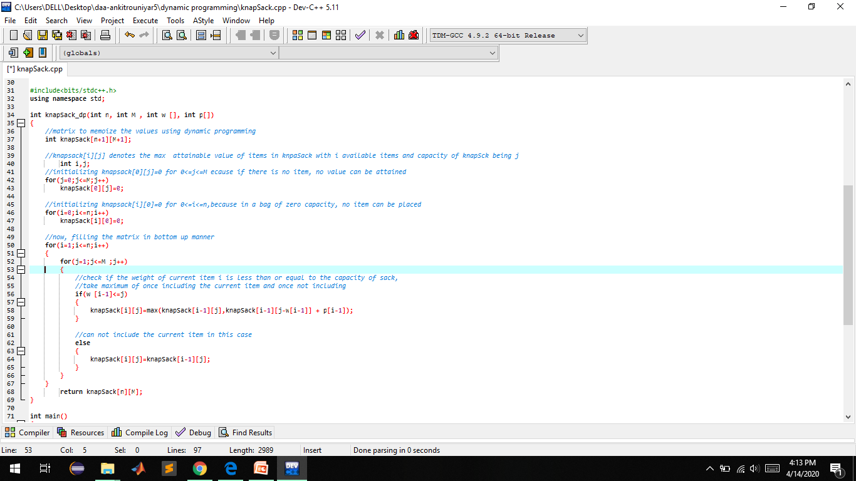

Slide 8
